Slide 1
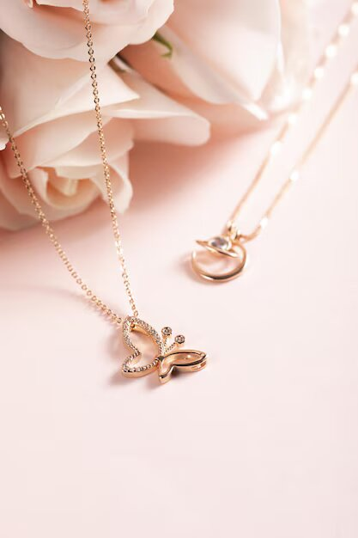

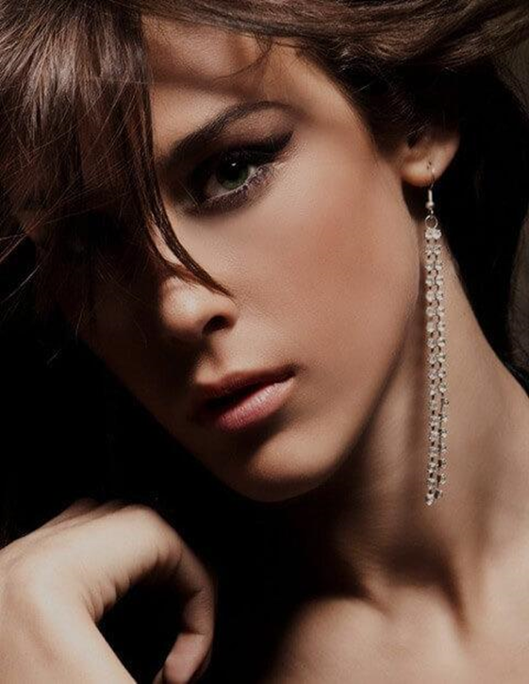
PASCAL
IMMITATION
JEWELLARY
Here is where our presentation begins

Slide 2
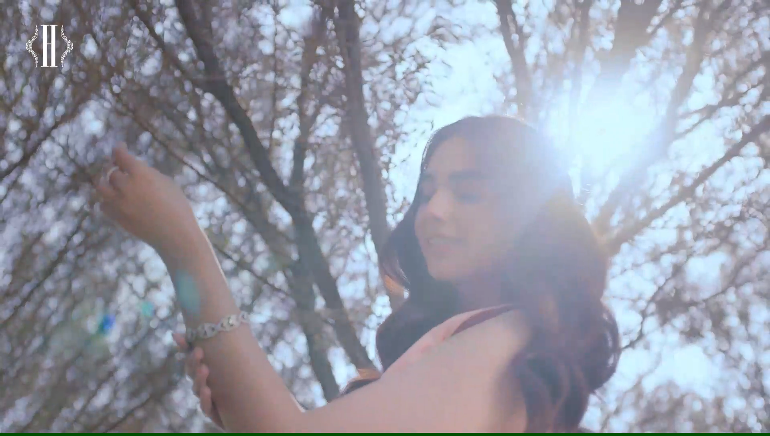
DEVELOPMENT TEAM
1.Alina Habib
2.Bisma Kamran
3.Firza Navaid
4.Zayyan Kamran

Slide 3

PROBLEM STATEMENT
"PASCAL IMITATION JEWELLERY” is one of the leading manufacturers and suppliers of Precious, Semi precious and Artificial Jewelry. They sell them under different brand names. The Quality of the products are renowned for striking features such as smooth polish, stunning design and excelling clarity, look and feature, luster. The shop owner wishes to have the website of the jeweler shop where in they want to describe all the type, brands of the product.

Slide 4

SOLUTIONS
The Web site is to be created based on the following requirements.
1.The home page must describe the keywords or highlight of the shop along with all navigation link defined.
2.The product must be categorized as per the “Brand”.
3.It should be followed by sub-category with the type (Original, Semi Precious, and Artificial).
4.Proper description of the product along with the image must be added in the website.
5.Comparison of the product must be included in the website. (like comparison between product designing same but one will be semi-Precious and other Artificial and so on).
6.Contact Us
7.About Us
8.Feedback form
9.Gallery section should be added.
10.Color combination must be uniform throughout the project.
11.Navigation must be smooth.

Slide 5
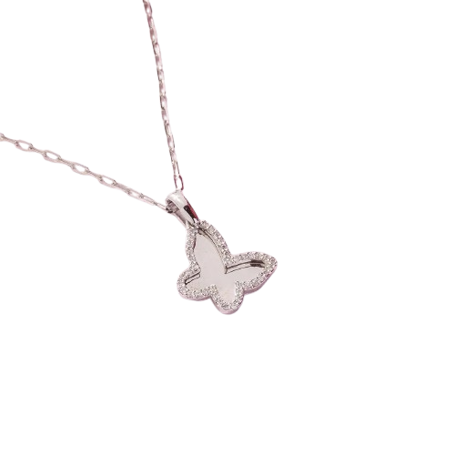
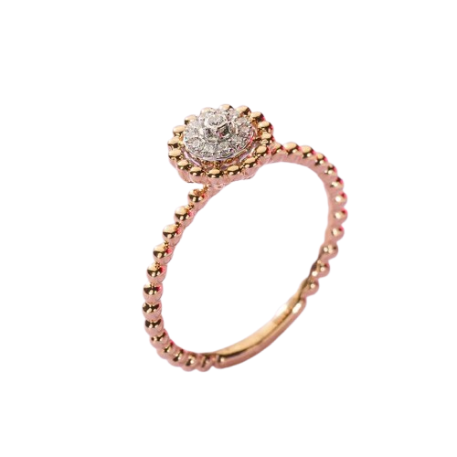
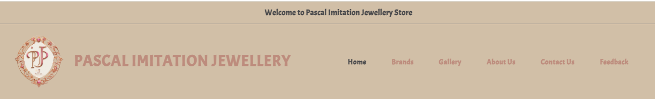
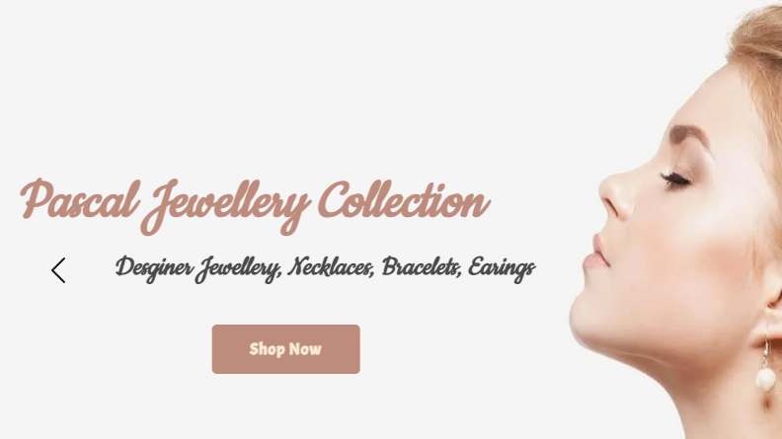
HOME

Slide 6
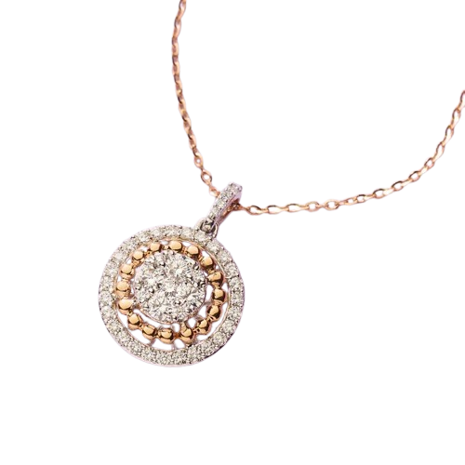
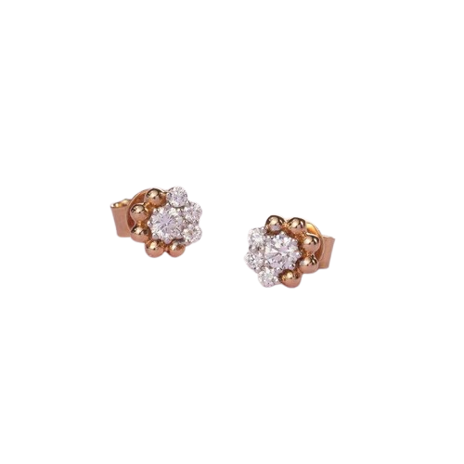
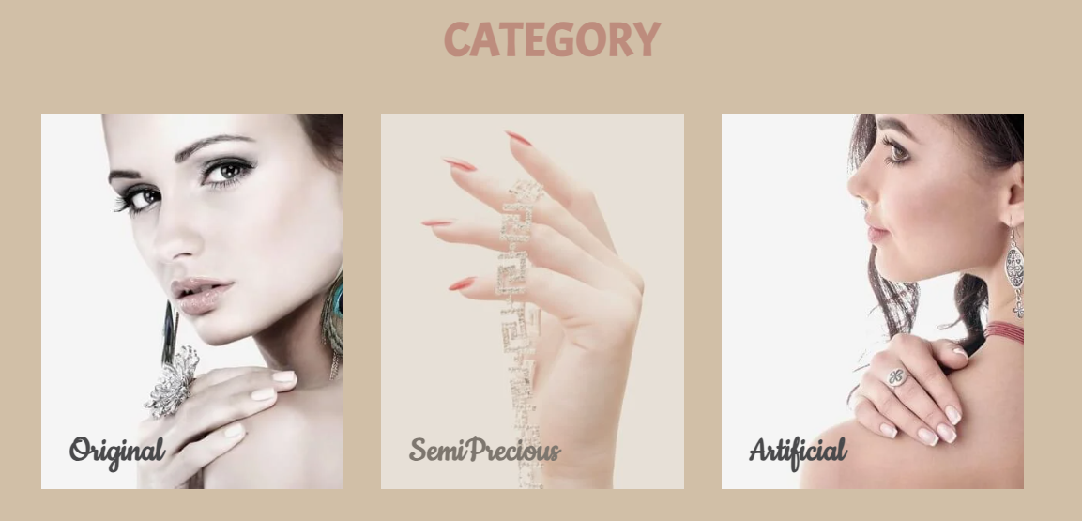
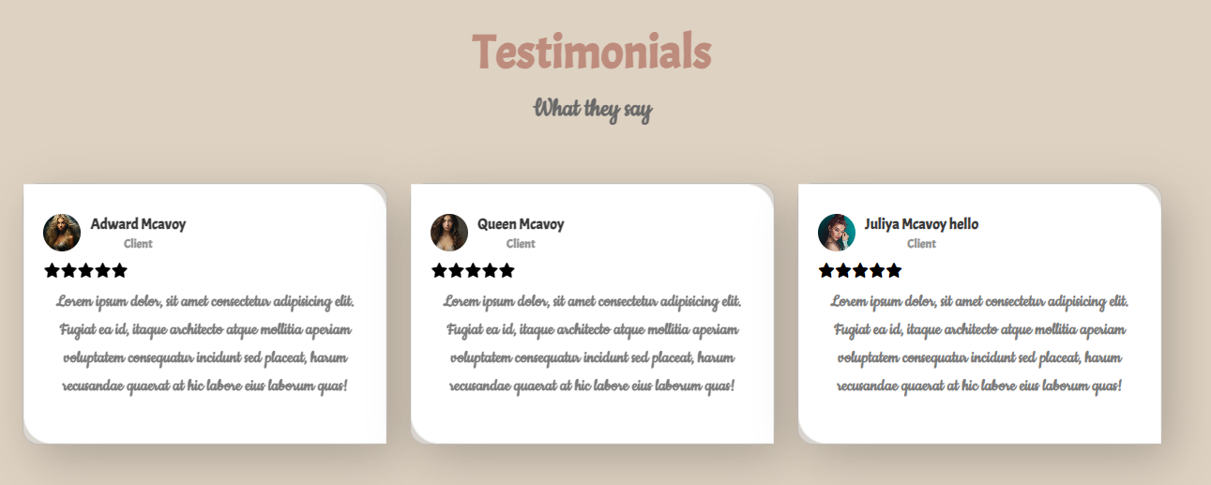


Slide 7

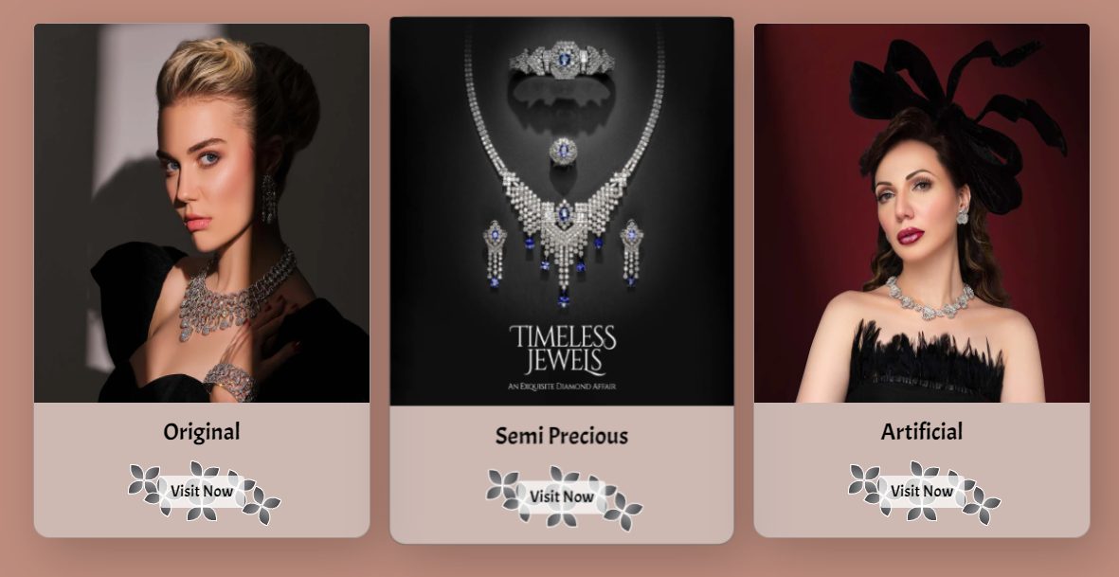
BRANDS

Slide 8

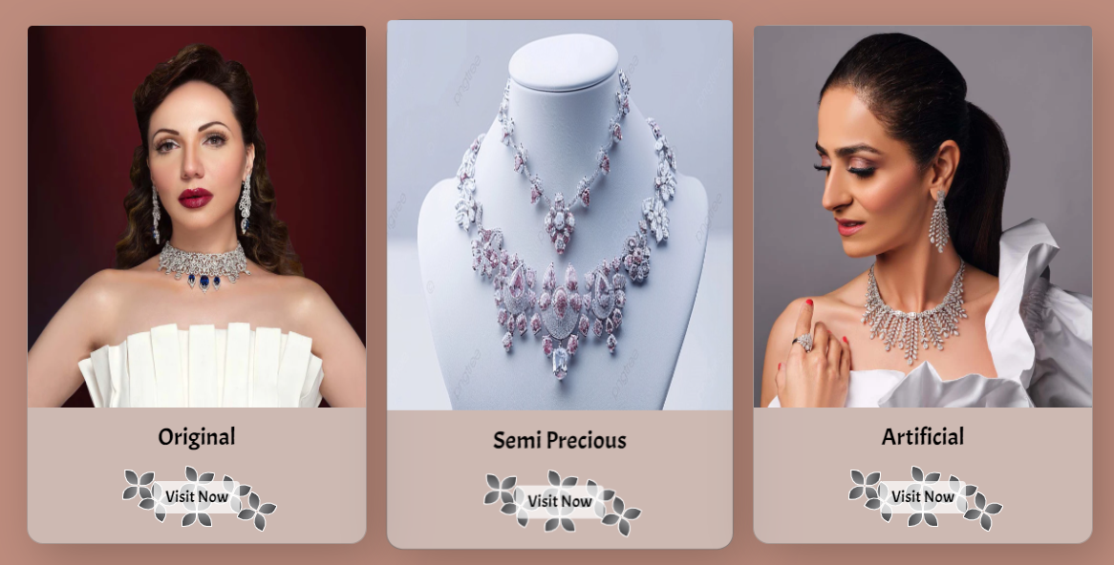

Slide 9
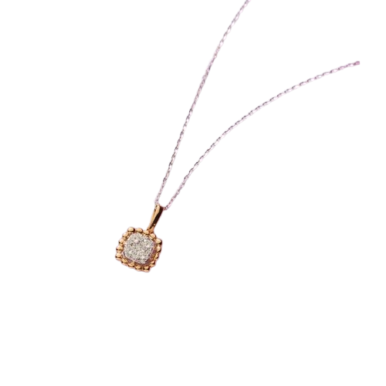

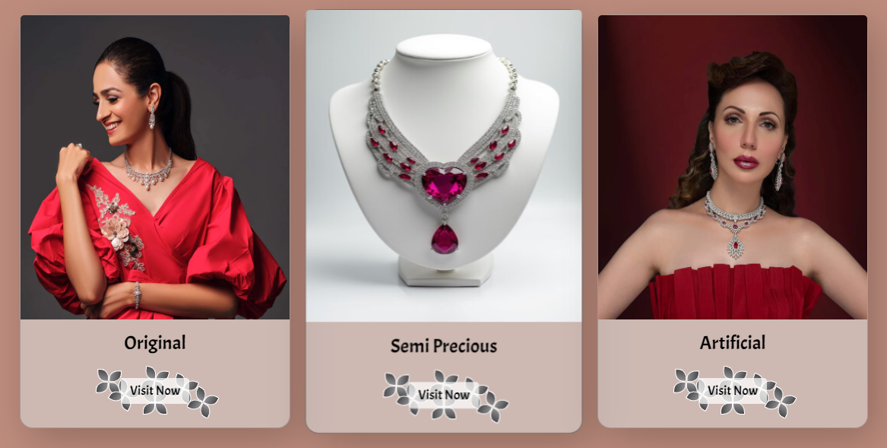

Slide 10

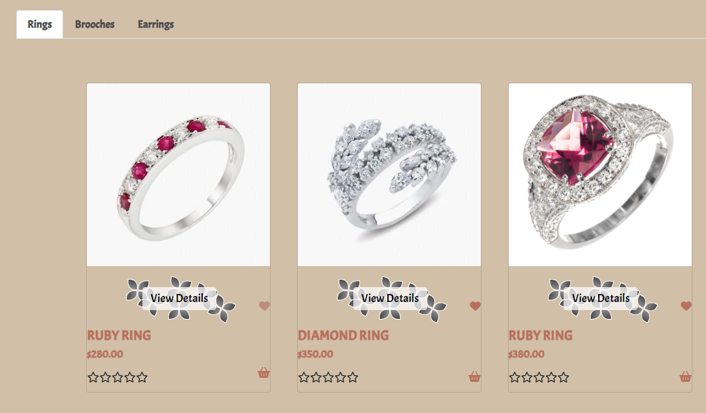
GALLERY

Slide 11
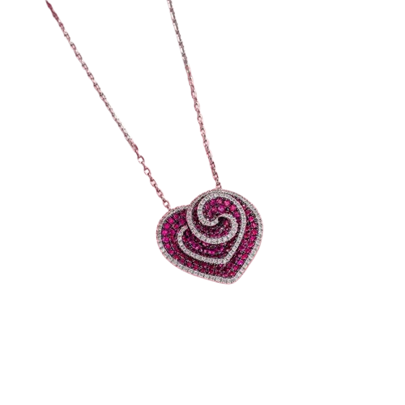

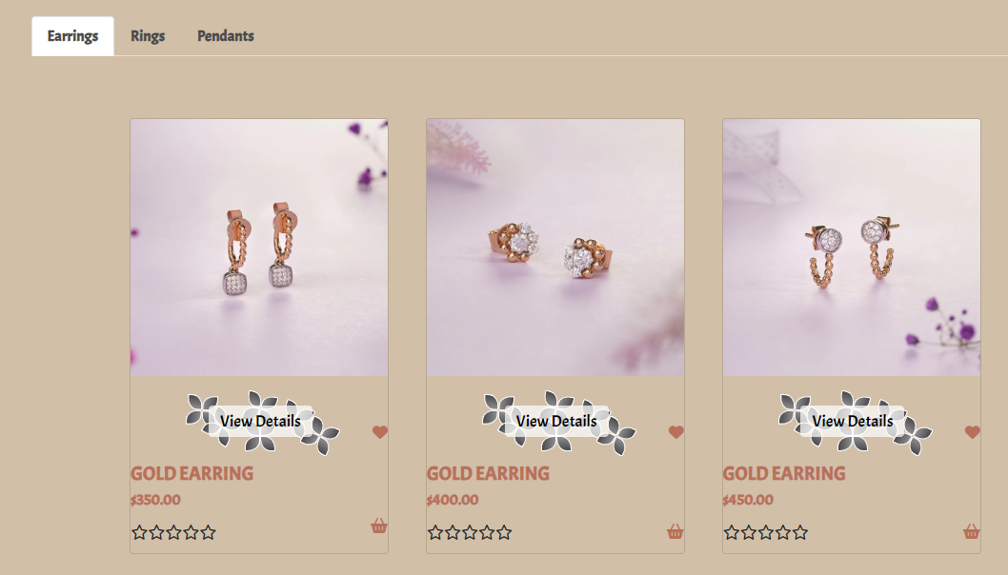

Slide 12
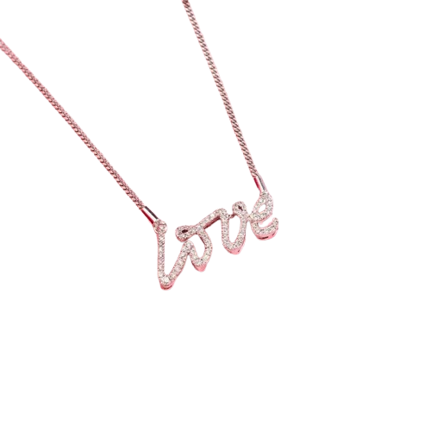

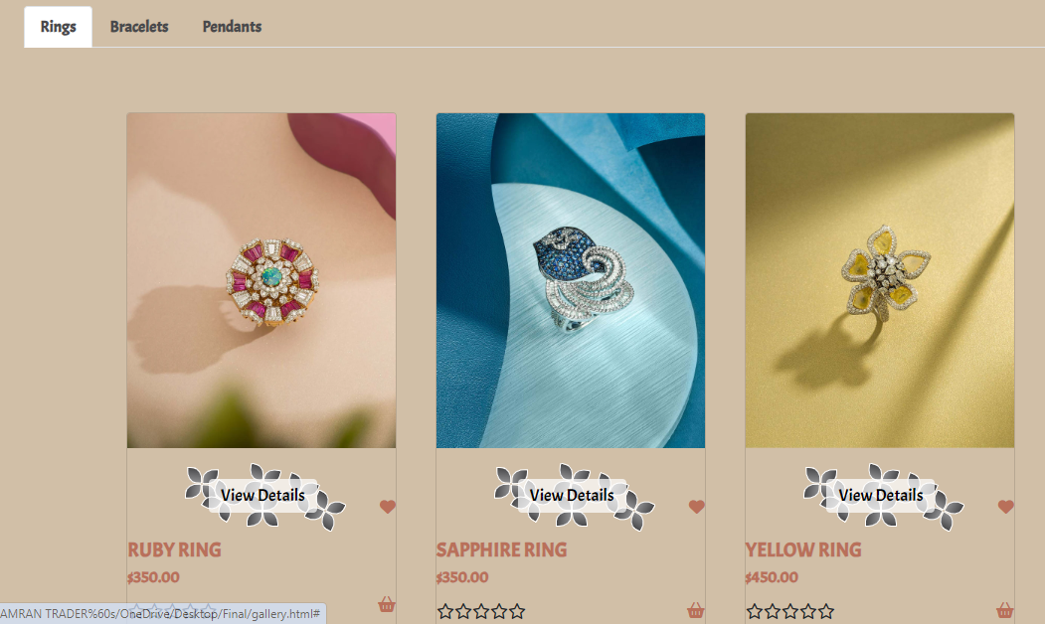

Slide 13
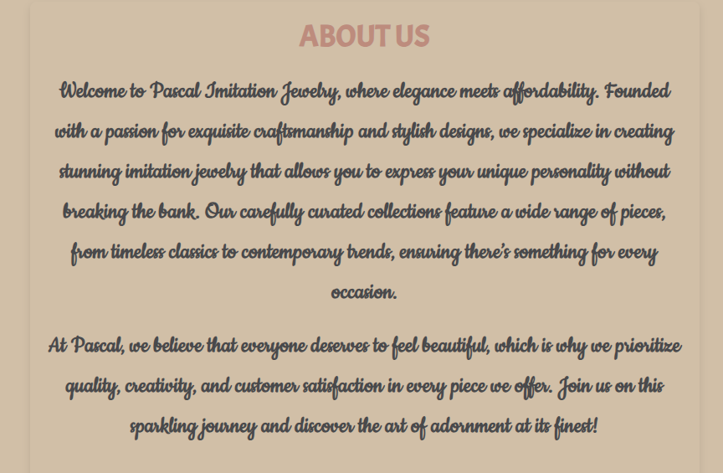
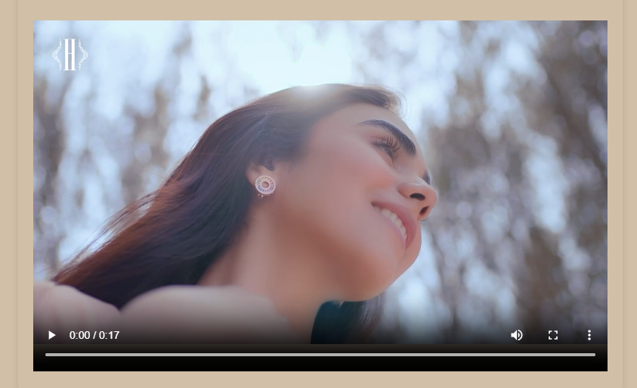
ABOUT US

Slide 14
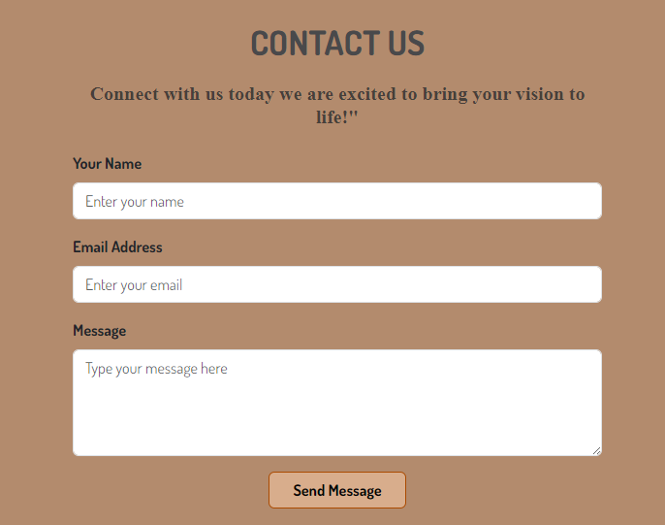
CONTACT US

Slide 15
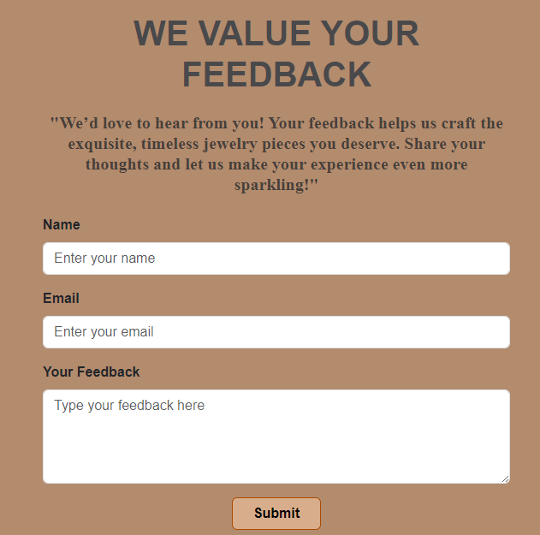
FEEDBACK

Slide 16
THANK YOU

